Slide 1
Data refers to any collection of information, facts, or statistics that can be stored, processed, and interpreted to derive meaningful insights. Data can take many forms, such as numbers, text, images, audio, video, and more. In the context of computing and technology, data is often represented and manipulated using binary code (0s and 1s), which forms the basis of all digital information.
A database, on the other hand, is a structured collection of data that is organized and stored in a way that allows for efficient storage, retrieval, and manipulation. Databases are designed to manage large volumes of data, making it easier to store, access, update, and analyze information. They are used in various applications such as business operations, scientific research, e-commerce, social media, and more.
Databases typically consist of tables, which are structured collections of data organized into rows and columns. Each row represents a record, and each column represents a field or attribute of that record. Databases provide mechanisms for querying (retrieving specific data), updating, and deleting data, as well as for ensuring data integrity, security, and scalability.

Slide 2
There are different types of databases, including:
Relational Databases: These databases use a structured schema where data is organized into tables with predefined relationships between them. Examples include MySQL, PostgreSQL, Microsoft SQL Server, and Oracle Database.
NoSQL Databases: These databases are designed to handle unstructured or semi-structured data and offer more flexible schemas. They include types like document stores (MongoDB), key-value stores (Redis), column-family stores (Cassandra), and graph databases (Neo4j).
In-Memory Databases: These databases store data in system memory (RAM) instead of on disk, leading to faster data retrieval. Examples include Redis and Memcached.
Graph Databases: These databases are optimized for managing data with complex relationships, making them suitable for applications like social networks and recommendation systems. Neo4j is a well-known example.
Time-Series Databases: These databases are designed to handle and analyze time-stamped data, commonly used in applications like IoT sensor data and financial trading systems.
Spatial Databases: These databases specialize in storing and querying spatial data, such as geographic information system (GIS) data used for mapping and location-based applications.

Slide 3
SQL (Relational Databases):
Data Model:
Relational databases store data in structured tables with predefined schemas.
Example: In a student database, you might have a "Students" table and a "Courses" table with defined relationships.
Schema:
Rigid schema: Changes to the schema require careful planning and may affect existing data.
Example: MySQL, PostgreSQL.
Data Relationships:
Well-defined relationships using primary and foreign keys.
Example: A "Customers" table linked to an "Orders" table using customer IDs.
Query Language:
SQL (Structured Query Language) is used for querying and managing data.
Example: SELECT * FROM Employees WHERE Department = 'Sales'.
Transactions:
ACID (Atomicity, Consistency, Isolation, Durability) compliance ensures data integrity.
Example: In banking, transferring money from one account to another is an atomic operation.

Slide 4
NoSQL Databases:
Data Model:
Various data models: document, key-value, column-family, graph, etc.
Example: MongoDB (document), Redis (key-value), Neo4j (graph).
Schema:
Flexible schema: Allows dynamic changes to data structure.
Example: In a document database, each document can have different fields.
Data Relationships:
Flexibility: Relationships can be defined but may be less rigid than in relational databases.
Example: In a document database, a blog post can embed comments as sub-documents.
Query Language:
NoSQL databases often use their own query languages.
Example: MongoDB's query language for document databases.
Transactions:
Eventual consistency: May not provide full ACID compliance due to distributed nature.
Example: In a distributed system, data changes might take some time to propagate.
Scalability:
Horizontal scaling (sharding) is common, enabling databases to handle large amounts of data and traffic.
Example: Cassandra's ability to distribute data across nodes.

Slide 5
Why Choose SQL:
When data has a structured schema and well-defined relationships.
For applications requiring complex querying, reporting, and analytics.
When data integrity, consistency, and ACID compliance are crucial (e.g., financial applications).
When dealing with a smaller dataset that fits well in a single server's resources.
Why Choose NoSQL:
For handling large volumes of unstructured or semi-structured data.
When data schema is dynamic or evolving frequently.
For applications with high write and read volumes and the need for fast data retrieval.
When scalability across multiple servers or nodes is required.
In scenarios where real-time data processing and low latency are critical.

Slide 6
Atomicity:
Atomicity ensures that a transaction is treated as a single, indivisible unit of work. Either all the changes within the transaction are successfully completed, or none of them are applied.
If a transaction fails at any point, all changes made so far are rolled back, and the database is left in its original state.
Example: Imagine transferring money from one bank account to another. The transaction deducts the amount from one account and credits it to another. If the transfer fails midway, neither account should be affected.
Consistency:
Consistency ensures that a transaction brings the database from one valid state to another. It enforces any defined constraints or rules and maintains data integrity.
The database should remain consistent before and after the transaction, even if it involves multiple operations.
Example: If a transaction involves transferring money between accounts, the sum of account balances before and after the transaction should be the same, ensuring that no money is created or lost during the process.
Isolation:
Isolation ensures that multiple transactions can occur concurrently without interfering with each other. Transactions are isolated from one another until they are completed.
Each transaction should appear to be executed in isolation, regardless of the actual order of execution.
Example: If two users attempt to transfer money simultaneously, their transactions should not affect each other. The balance updates should occur independently and consistently.
Durability:
Durability guarantees that once a transaction is successfully committed, its changes are permanent and will survive any system failures (e.g., power loss, crashes).
Committed changes are stored in a durable medium, typically a disk, to ensure that they are not lost.
Example: After a successful money transfer transaction, the changes to account balances are permanently recorded, even if the system crashes immediately afterward.

Slide 7
Schema Flexibility: NoSQL databases like MongoDB offer a flexible schema design, allowing you to store different types of data within the same collection without a predefined schema. This flexibility is especially beneficial during the development phase when requirements may change frequently.
Object-Oriented Nature: NoSQL databases, particularly document-oriented ones like MongoDB, map well to object-oriented programming paradigms used in JavaScript (used with both React and Node.js). Data stored as JSON-like documents in NoSQL databases can be directly consumed in JavaScript applications without extensive mapping or conversion.
JSON-Like Format: NoSQL databases store data in formats like JSON, which closely aligns with the way data is represented in JavaScript objects. This makes it easier to work with data within the stack's components (React, Node.js).
Scalability: NoSQL databases are designed for horizontal scalability, which is crucial for handling the potentially large user bases of modern web applications. MongoDB, for example, can distribute data across multiple servers or clusters to handle increased traffic.

Slide 8
5.Agile Development: In the fast-paced development environment of web applications, where requirements evolve rapidly, NoSQL databases' schema flexibility allows developers to adapt to changing needs more easily compared to traditional SQL databases.
6.Document-Oriented Approach: NoSQL databases like MongoDB are well-suited for scenarios where data is naturally hierarchical or nested, which is common in web applications. Documents can contain arrays and nested documents, mirroring the structure of modern web applications' UI components.
7.Read/Write Performance: Many NoSQL databases, including MongoDB, excel at high-speed read and write operations. This is important for real-time applications that require quick response times and dynamic updates.
8.Geospatial Capabilities: MongoDB provides strong support for geospatial data and queries, making it well-suited for location-based applications, maps, and geospatial analysis.
9. Real-Time Data: NoSQL databases are often favored for applications that require real-time updates and dynamic data synchronization, such as messaging apps, social networks, and collaborative tools.

Slide 9
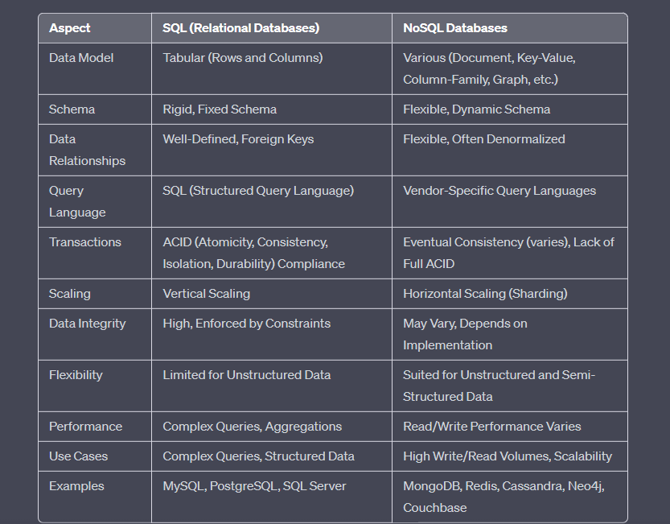

Slide 10
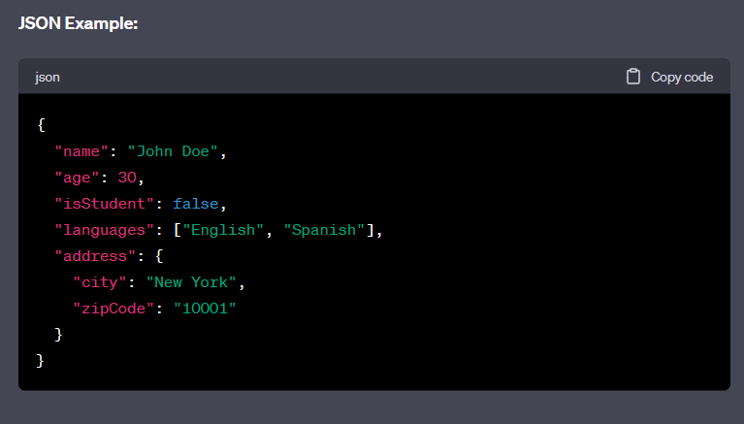
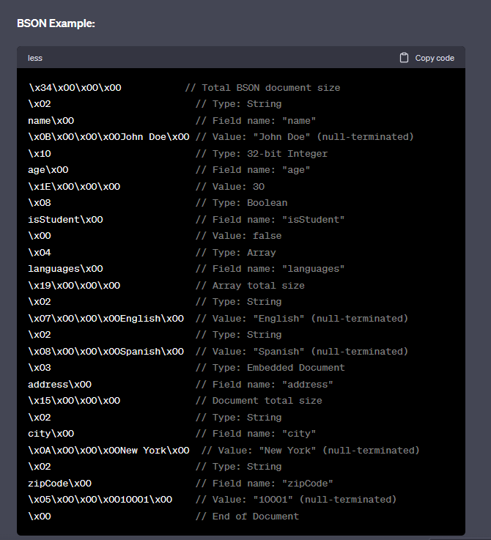

Slide 11
File System:
A file system is a method for organizing and storing files and data on storage devices like hard drives or network storage.
It provides a hierarchical structure of directories (folders) and files, much like a filing cabinet.
It's suitable for basic storage and retrieval of files, but doesn't provide advanced querying, relationships, or structured data management.
Each file is typically associated with a filename, extension, and location in the directory structure.
File systems are often used for personal files, documents, images, and program files.
They lack features like data relationships, querying capabilities, and transactions.
Examples of file systems include FAT32, NTFS (used in Windows), HFS+ (used in macOS), and ext4 (used in Linux)
Database:
A database is a structured collection of data organized for efficient storage, retrieval, and manipulation.
It offers features like data integrity, consistency, transactions, and powerful querying.
Databases can be relational (SQL) or non-relational (NoSQL), each catering to different data storage and retrieval needs.

Slide 12
Key Differences:
Data Structure:
File systems store data in files and folders, without inherent support for complex relationships between data elements.
Databases store data in structured tables with well-defined relationships, allowing for efficient data retrieval and manipulation.
Data Integrity and Consistency:
Databases enforce data integrity and consistency through constraints, normalization, and transaction management.
File systems do not inherently enforce data integrity and are more limited in terms of maintaining consistent relationships between data elements.
Querying and Reporting:
Databases provide powerful querying capabilities using SQL, allowing for complex queries and data retrieval based on various criteria.
File systems offer basic file operations but lack sophisticated querying and reporting features.
Concurrency and Multi-User Support:
Databases manage concurrent access by multiple users to ensure data consistency.
File systems might not handle concurrent access and data consistency as effectively in multi-user scenarios.

Slide 13
A schema is a fundamental concept in database management systems that defines the structure, organization, and relationships of the data stored in a database. It serves as a blueprint for how data is organized and represented within the database.
A schema provides a structured framework for organizing data within a database, ensuring data consistency, integrity, and efficient querying. It serves as a guideline for both database designers and users on how data is structured and manipulated within the database syste
The schema specifies the following aspects:
Table Structure: In a relational database, the schema defines the tables that will hold the data. Each table has a set of columns, and each column has a defined data type (such as text, number, date) that specifies what kind of data can be stored in that column.
Column Constraints: The schema also specifies constraints on columns, such as whether a column must contain a unique value (a primary key constraint), whether a column can contain null values, and whether certain values are allowed (data validation constraints).
Relationships: For relational databases, the schema outlines the relationships between tables. These relationships are established using keys—specifically, primary keys and foreign keys—which help maintain data integrity and enable data retrieval across related tables.

Slide 14
4.Indexes: Schema definition also includes decisions about which columns need indexing. Indexes enhance the efficiency of data retrieval operations by creating data structures that speed up the search process.
5.Data Integrity Rules: The schema can enforce rules to maintain the consistency and integrity of the data. This might involve specifying that certain data values are required, setting up referential integrity between related tables, and defining rules for data validation and transformation.
6.Views: A schema can include the definition of database views. Views are virtual tables that display data from one or more underlying tables in a customized way, often to simplify complex queries or present specific subsets of data to users.
7.Security and Permissions: Schema definition can also involve specifying access controls and permissions, determining who can read, write, modify, or delete data within the database.

Slide 15
What Is Difference Between Collections and Tables
Collections:
Collections are a term commonly used in NoSQL databases, especially in document-oriented databases like MongoDB.
In a NoSQL context, a collection is a grouping of similar or related documents. A document is a data structure that contains key-value pairs, similar to a JSON object.
Each document within a collection can have a different structure, meaning that different documents can have different fields.
Collections are schema-flexible, allowing you to add new fields to documents without affecting others in the collection.
Collections are used to store data in a semi-structured or unstructured format.
Tables:
Tables are the fundamental structure in relational databases.
In a relational database, a table is a two-dimensional structure made up of rows and columns.
Each row represents a record, and each column represents an attribute or field of that record.
The structure of a table is defined by its schema, which specifies the columns and their data types.
All rows in a table follow the same structure defined by the schema. Any changes to the schema typically affect the entire table.
Relational databases enforce data integrity through defined relationships between tables and use the concept of keys (primary keys and foreign keys) to ensure data consistency.

Slide 16
Install MongoDB: official MongoDB website (https://www.mongodb.com/try/download/community).
Start MongoDB Server: Once MongoDB is installed, you'll need to start the MongoDB server. Open your command prompt or terminal and navigate to the directory where MongoDB is installed. Run the following command to start the MongoDB server:

Slide 17
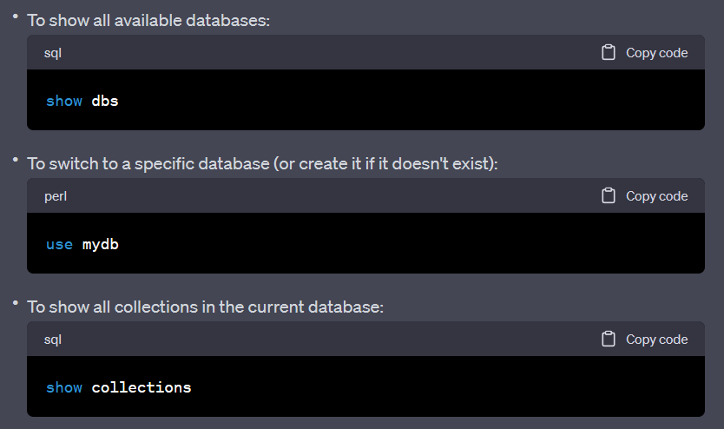
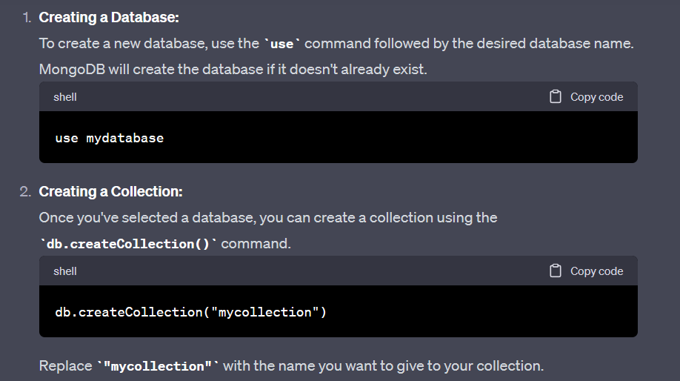

Slide 18
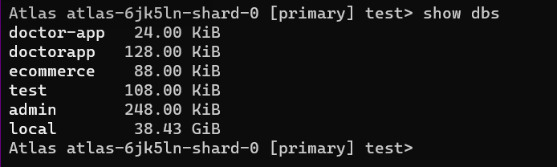
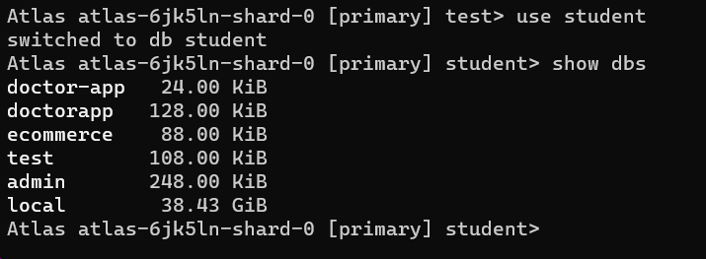
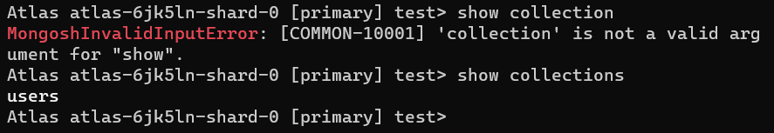
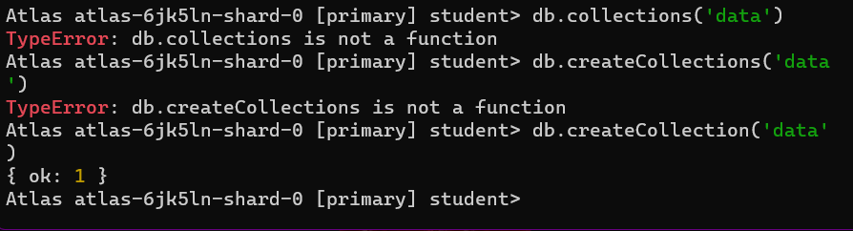
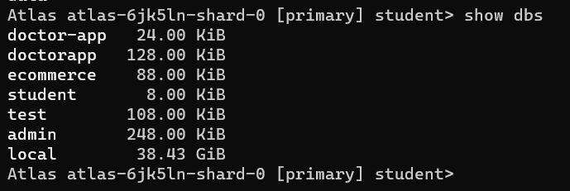

Slide 19
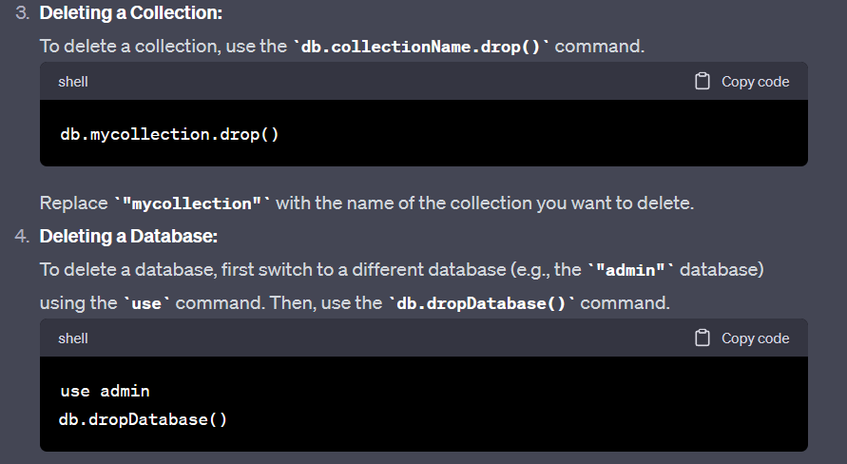
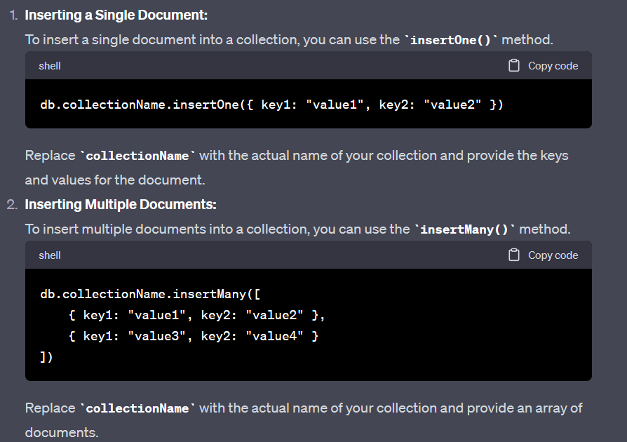
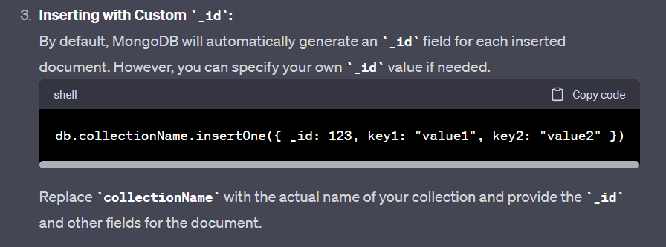

Slide 20
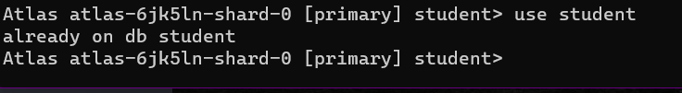
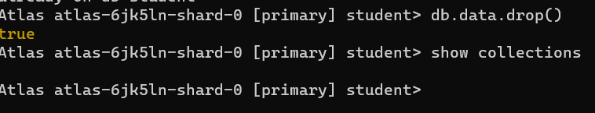
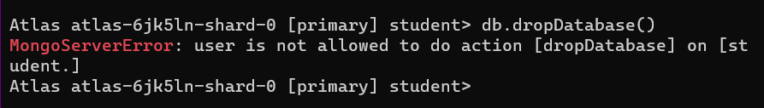
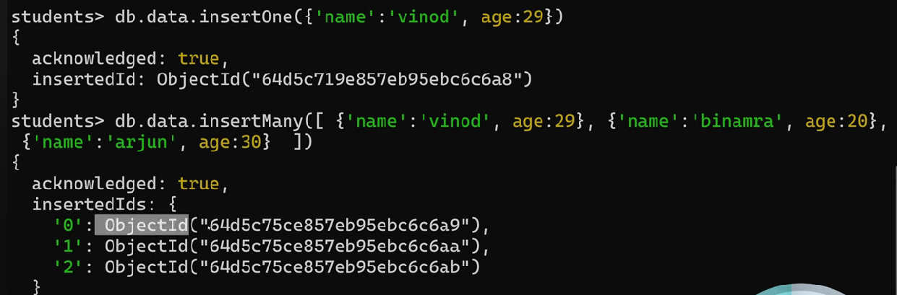

Slide 21
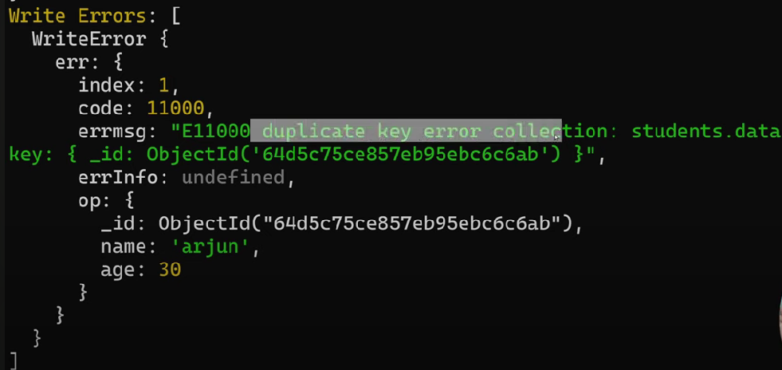

Slide 22
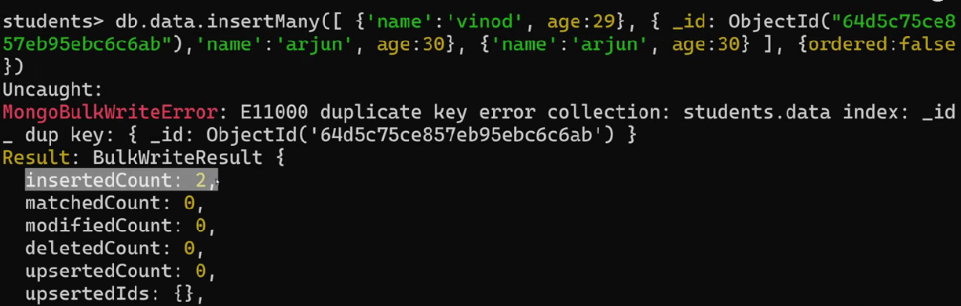
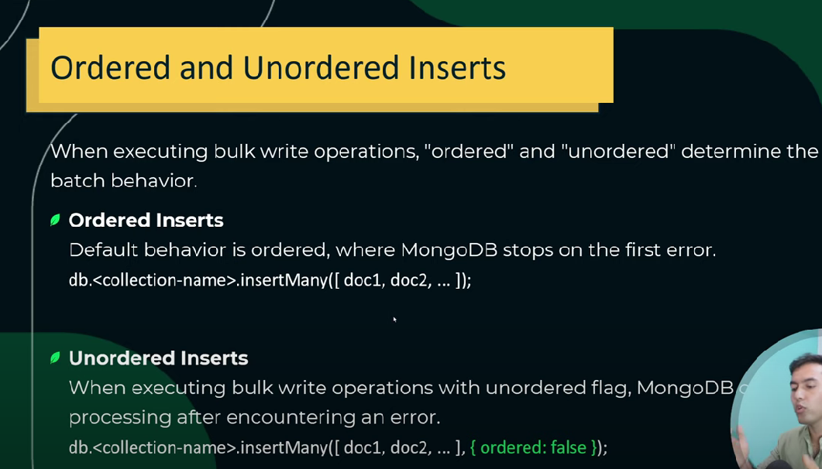

Slide 23
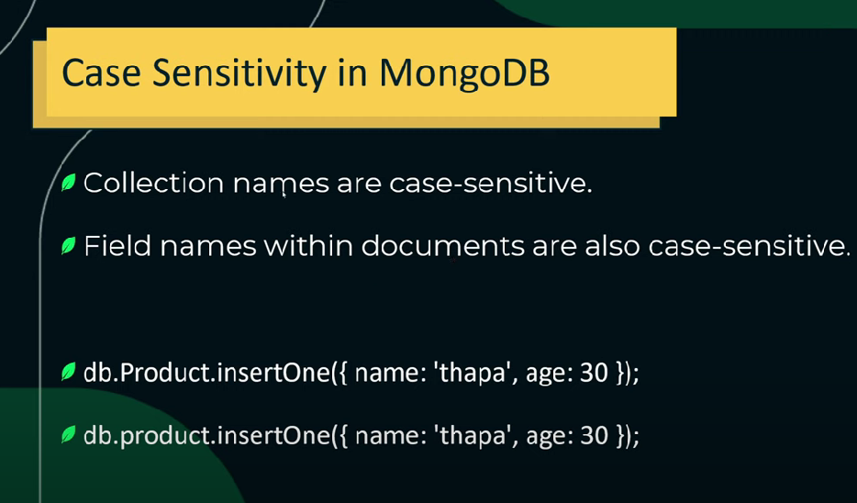

Slide 24
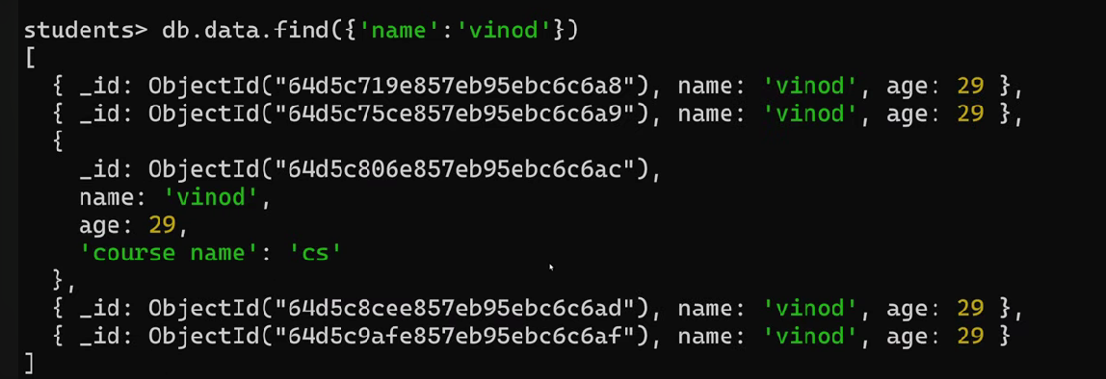

Slide 25
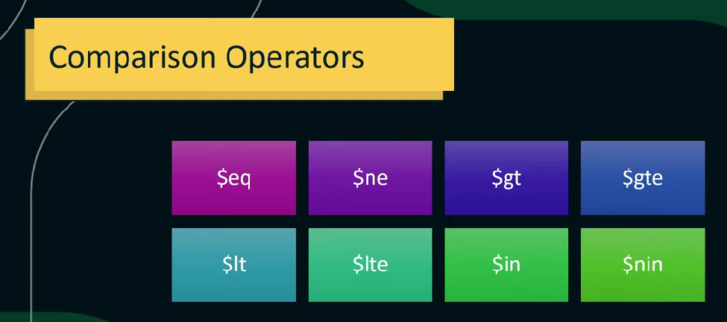

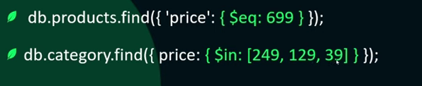

Slide 26
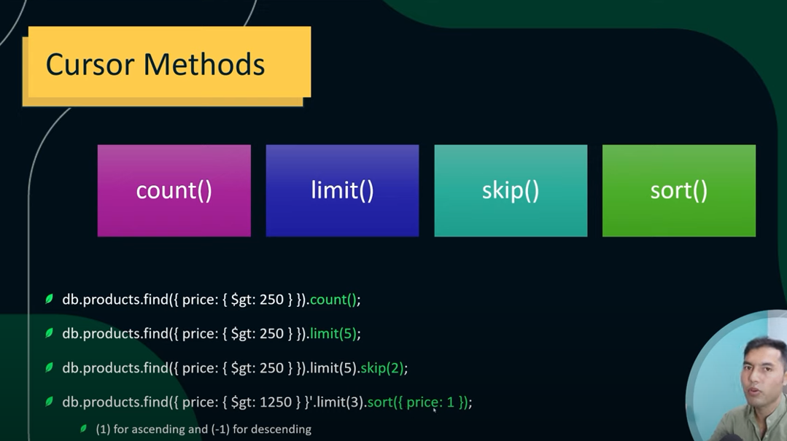

Slide 27
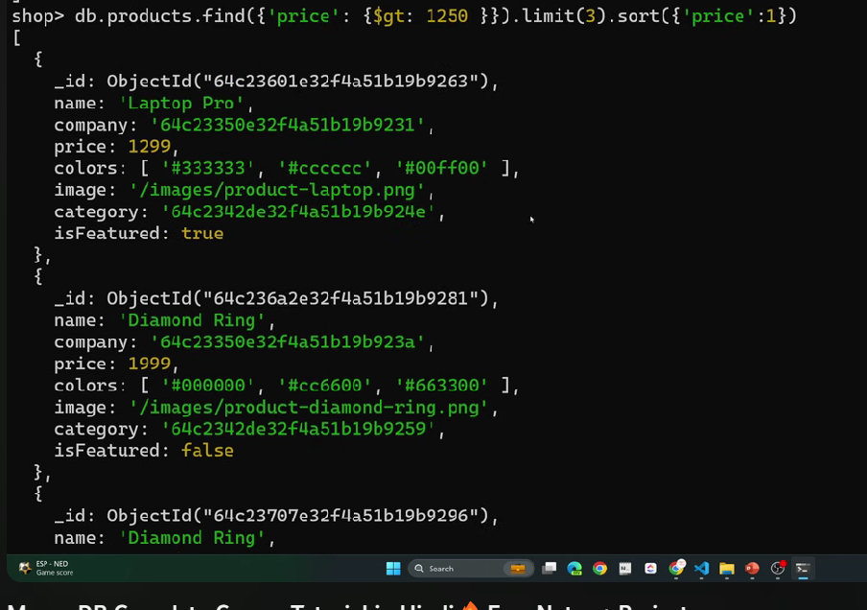

Slide 28
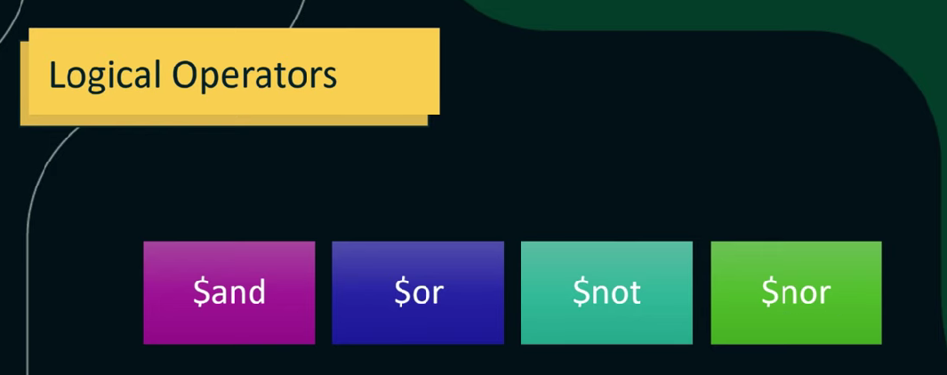
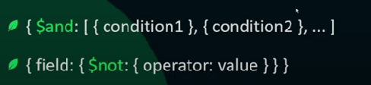
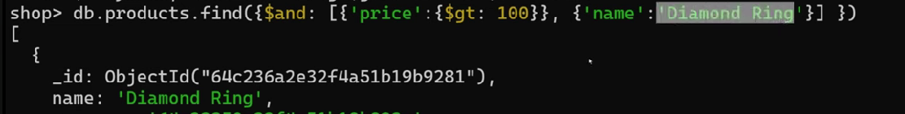

Slide 29
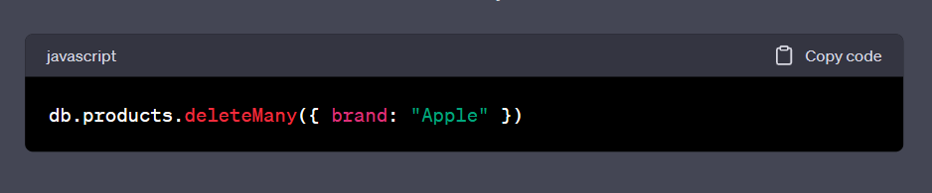
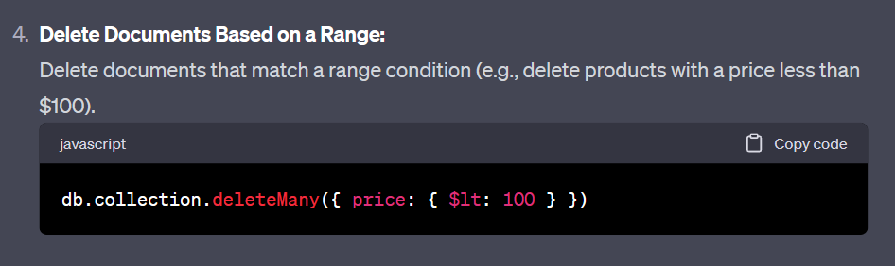
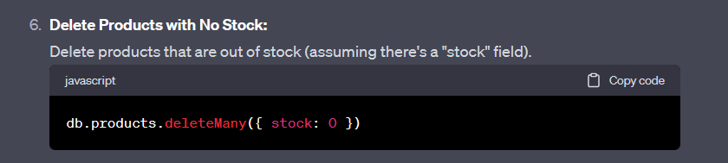

Slide 30
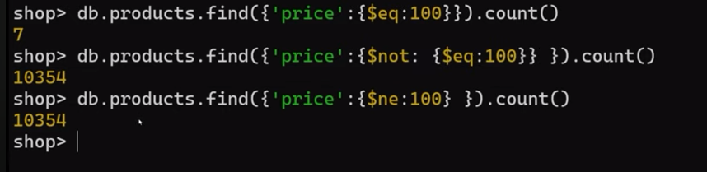

Slide 31
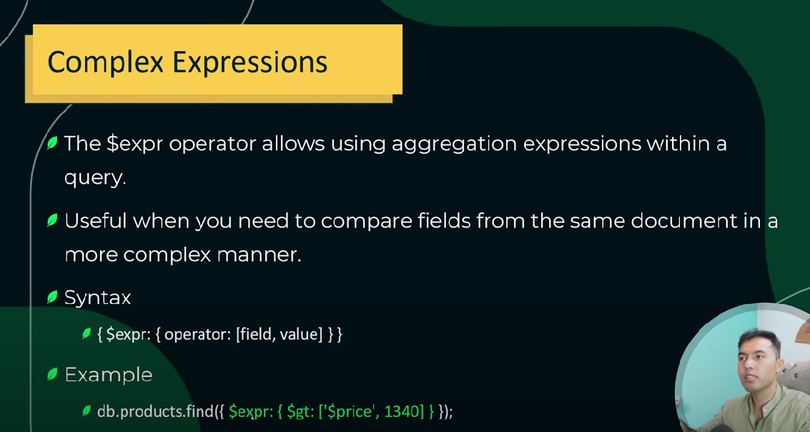
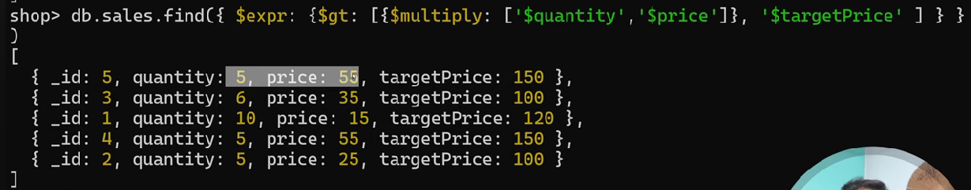

Slide 32
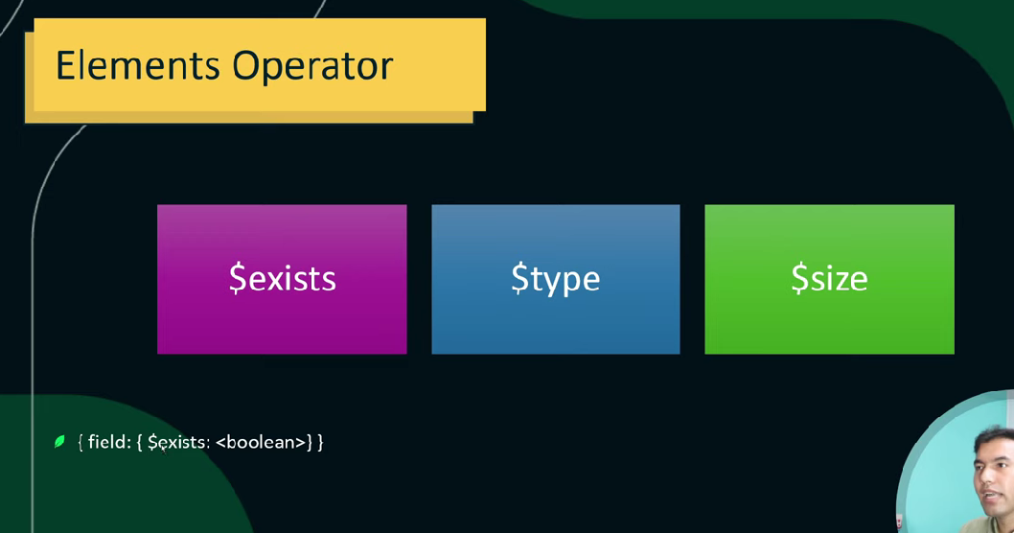
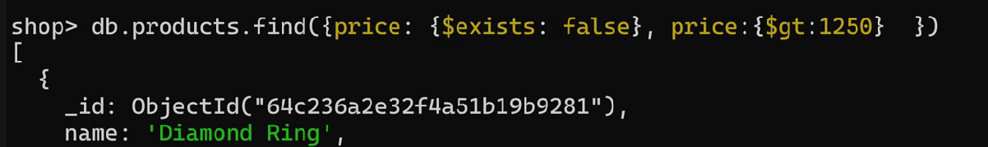

Slide 33
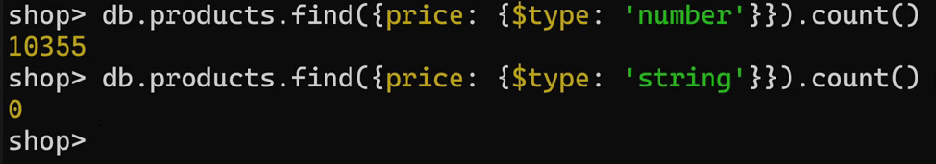


Slide 34
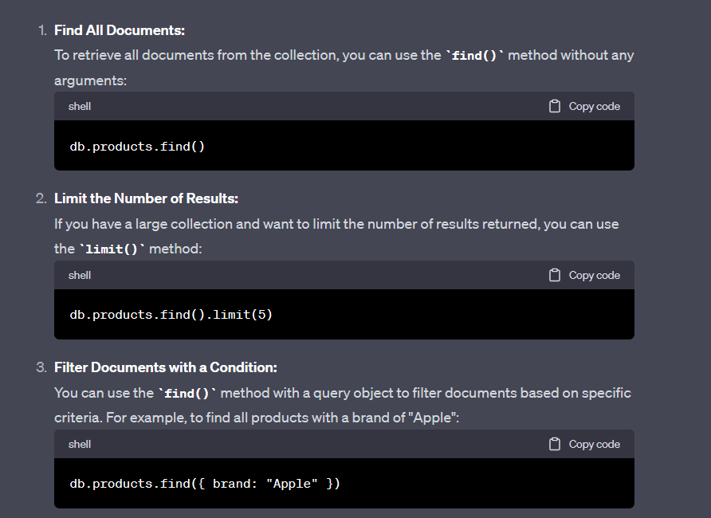
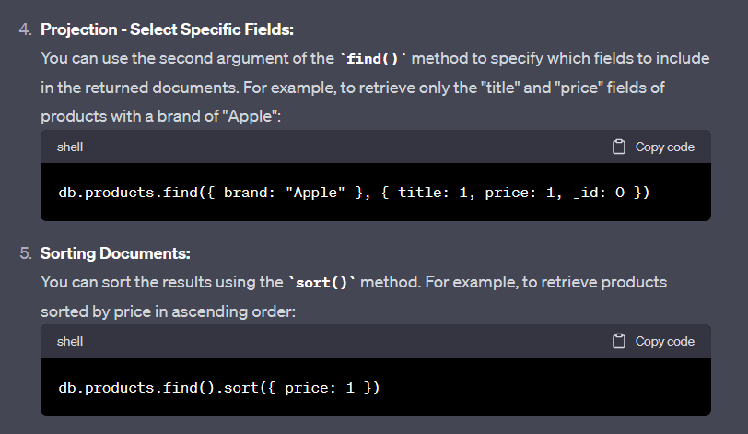

Slide 35
1. **Product Information:**
- What are the details of the product with ID 5?
- List all products from the "laptops" category.
- Retrieve the title, price, and brand of products with a discount percentage greater than 15%.
2. **Brand and Category Queries:**
- How many products belong to the "Samsung" brand?
- Find all products that are categorized as "smartphones" and have a rating greater than 4.5.
- Which brands have products in the "fragrances" category?
3. **Price and Discount Queries:**
- What is the average price of all products?
- Show the products with a price between $30 and $50.
- List the top 5 products with the highest discounts.
4. **Stock and Availability:**
- How many products have a stock quantity of less than 50?
- Find the products that are out of stock (stock = 0).
- Which category has the highest total stock quantity?
5. **Rating and Reviews:**
- Retrieve products that have a rating above 4.8 and at least 100 units in stock.
- List the products with a rating below 4.0 and provide their titles and descriptions.
- Calculate the average rating for products in the "skincare" category.

Slide 36
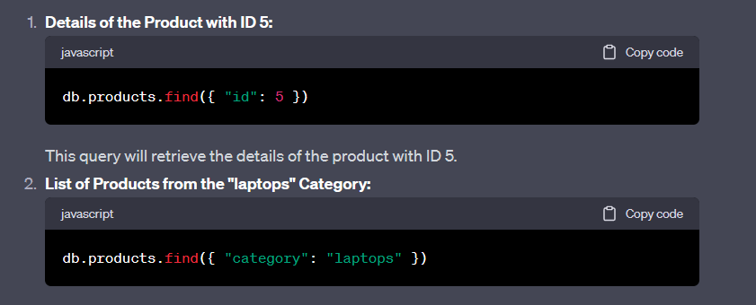
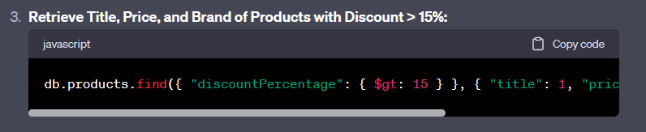
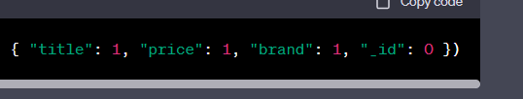
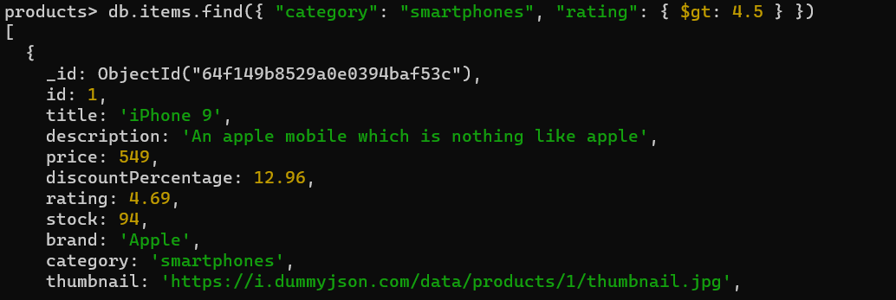

Slide 37
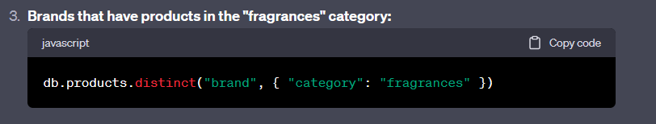
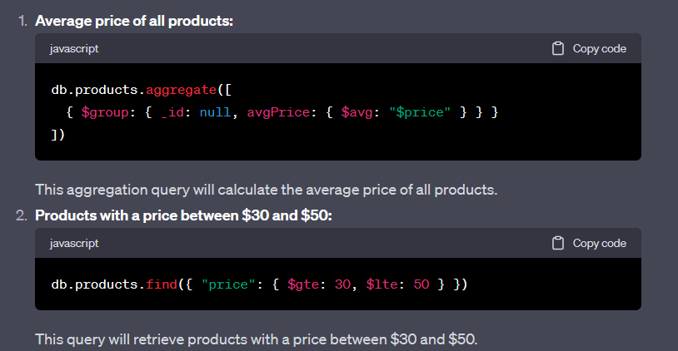
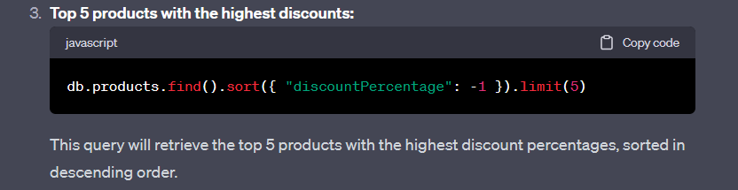

Slide 38
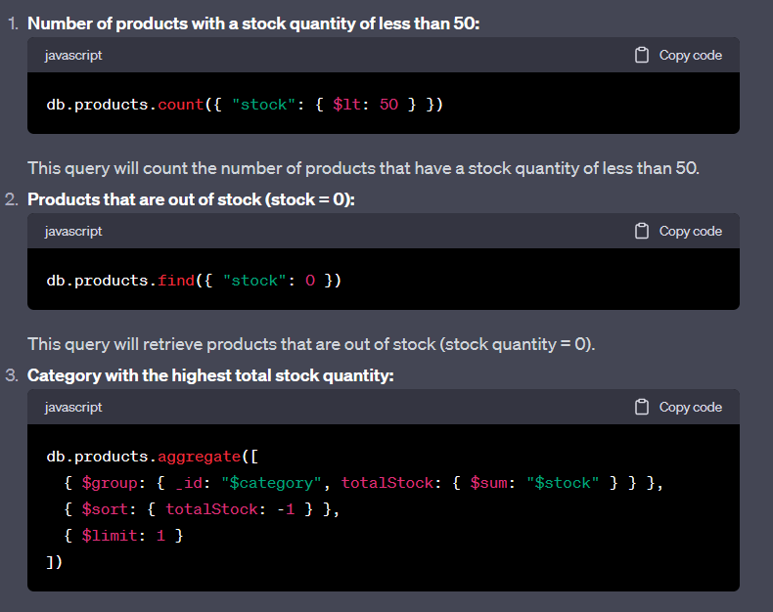
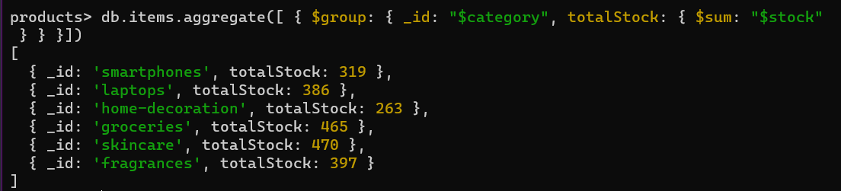

Slide 39
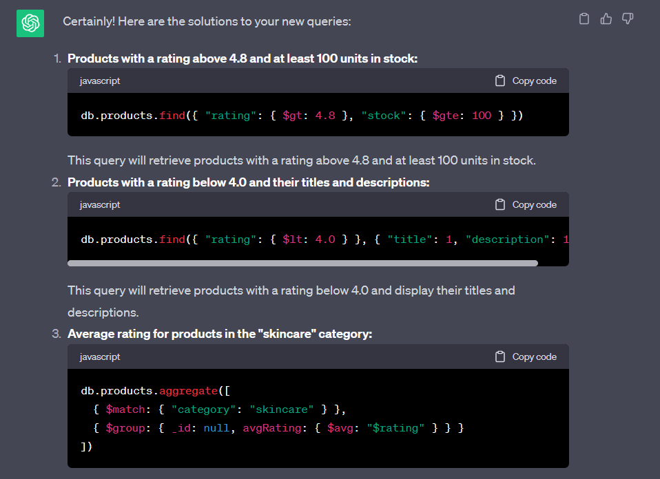

Slide 40



Slide 41
. **Image URLs and Thumbnails:**
- Show the URLs of images associated with the product with ID 10.
- Retrieve the thumbnails of products with a brand of "Apple".
7. **Mixed Queries:**
- List products with a discount percentage between 10% and 20% and a rating greater than 4.2.
- Find laptops that are priced above $1000 and have a rating above 4.5.
8. **Category Analysis:**
- How many products are there in each category? Provide a count for each category.
9. **Brands and Discounts:**
- Calculate the average discount percentage for each brand.
- Which brand has the highest average discount percentage?
10. **Combining Conditions:**
- Retrieve products from the "groceries" category with a price less than $15 and a stock quantity greater than 50.

Slide 42




Slide 43




Slide 44
11. **Best Selling Products:**
- List the top 5 best selling products based on their stock availability.
12. **Variety in Brands:**
- How many different brands are present in the dataset?
- Which brands have products in more than one category?
13. **Image Analysis:**
- Find products with the maximum number of images. Provide their titles and the number of images.
14. **Discount Distribution:**
- Create a histogram of discount percentages to visualize the distribution of discounts.
15. **Popular Categories:**
- Identify the category with the highest average rating.
- List the categories in descending order of the average rating.
16. **Brand Comparison:**
- Compare the average ratings of products from "Apple" and "Samsung" brands.
- Compare the average prices of products from "HP Pavilion" and "Dermive" brands.
17. **Stock vs. Discount:**
- Analyze the relationship between stock availability and discount percentages. Do products with lower stock tend to have higher discounts?

Slide 45




Slide 46



Slide 47



Slide 48



Slide 49
18. **Category Insights:**
- Show the products in the "home-decoration" category with ratings above 4.5.
- Calculate the average price of products in the "skincare" category.
19. **Product Availability:**
- List products that are in stock and have a discount percentage greater than 10%.
20. **Comparison by Rating:**
- Compare the average ratings of products in the "smartphones" and "laptops" categories.
21. **Discount Range Analysis:**
- Calculate the percentage of products with discount percentages in the range of 5% to 15%.
22. **Brand and Price:**
- Find the brand with the highest average price.
- Find the brand with the lowest average price.
23. **High-Value Products:**
- Show the products with a price above $1000 and a discount percentage greater than 10%.

Slide 50
25. **Product and Category Count:**
- Count the number of products in each category and display the results.
26. **Limited Availability:**
- List products with a stock quantity of 20 or less.
27. **Discounted Fragrances:**
- Display the products in the "fragrances" category that have a discount percentage above 15%.
28. **Category Comparison:**
- Compare the average prices of products in the "groceries" and "home-decoration" categories.
29. **Best Value Products:**
- Identify the products with the highest rating-to-price ratio.
30. **Discounted Electronics:**
- List products in the "smartphones" and "laptops" categories that have a discount percentage greater than 10%.

Slide 51



Slide 52



Slide 53



Slide 54



Slide 55


Calculate the number of products in each price range (e.g., $0-500, $500-1000, $1000+) and display the results.
Compare the average prices of products in the "groceries" and "home-decoration" categories.

Slide 56



Slide 57



Slide 58


Slide 59



Slide 60


Slide 61


Slide 62


